Slide 1

Course Welcome
This course introduces resource management as described in the National Incident Management System (NIMS), and shows how systems for managing resources can be used to improve incident response. The course includes examples of best practices, lessons learned, and job aids to assist the participant in planning for resource management. Descriptions and details about the other NIMS-related courses may be found on the FEMA EMI Web site: https://training.fema.gov/is/.
Course Objectives: At the conclusion of this course, you should be able to:
•Define the four resource management tasks conducted in preparation for incident response.
•Identify the six primary tasks of resource management during an incident.
•Describe the use of mutual aid in incidents.

Slide 2
Student Introductions
Introduce yourself by providing:
  Your name and organization
  Your job title
  A brief statement of your experience with emergency or incident response, including resource management.
  One special issue about resource management that you would like to be able to resolve by taking this course.

Slide 3
Course Structure
This course is divided into the following units:
  Unit 1: Resource Management Overview
  Unit 2: Resource Management Planning
  Unit 3: Resource Typing, Personnel Qualification, and Readiness
  Unit 4: Resource Management During Incidents
  Unit 5: Resource Management and Complex Incidents
  Unit 6: Tabletop Exercise
  Unit 7: Course Summary and Final Exam

Slide 4
Lesson Overview
This lesson will introduce the National Incident Management System (NIMS) and NIMS resource management.

Slide 5

What is NIMS?

Slide 6

Homeland Security Presidential Directives
HSPD-5, Management of Domestic Incidents, identified steps for improved coordination in response to incidents. It required the Department of Homeland Security (DHS) to coordinate with other Federal departments and agencies and State, local, and tribal governments to establish a National Response Framework (NRF) and a National Incident Management System (NIMS).
HSPD-8, National Preparedness, directed DHS to lead a national initiative to develop a National Preparedness System—a common, unified approach to “strengthen the preparedness of the United States to prevent and respond to threatened or actual domestic terrorist attacks, major disasters, and other emergencies.”
Presidential Policy Directive 8 (PPD-8), National Preparedness, describes the Nation's approach to preparedness-one that involves the whole community, including individuals, businesses, community and faith-based organizations, schools, tribes, and all levels of government (Federal, State, local, tribal and territorial).

Slide 7
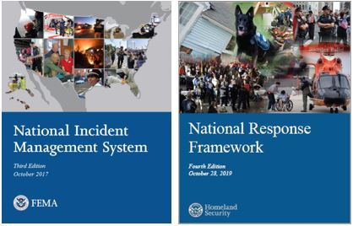
NIMS and NRF
NIMS guides all levels of government, nongovernmental organizations (NGO), and the private sector to work together to prevent, protect against, mitigate, respond to, and recover from incidents. NIMS provides stakeholders across the whole community with the shared vocabulary, systems, and processes to successfully deliver the capabilities described in the National Preparedness System. NIMS defines operational systems that guide how personnel work together during incidents. NIMS applies to all incidents, from traffic accidents to major disasters.
The NRF is a guide to how the Nation responds to all types of disasters and emergencies. It is built on scalable, flexible, and adaptable concepts identified in NIMS to align key roles and responsibilities across the Nation. The NRF describes the principles, roles and responsibilities, and coordinating structures for delivering the core capabilities required to respond to an incident.

Slide 8
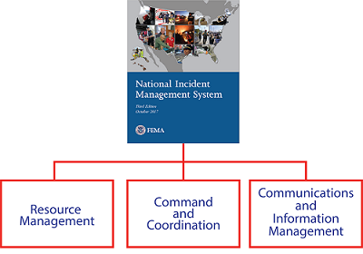
Major Components of NIMS
Jurisdictions and organizations involved in the management of incidents vary in their authorities, management structures, communication capabilities and protocols, and many other factors.
The major components of NIMS provide a common framework to integrate these diverse capabilities and achieve common goals.

Slide 9
What is NIMS Resource Management?

Slide 10
Unit Summary
This unit introduced you to NIMS and NIMS Resource Management. In the next lesson, you will learn how jurisdictions work together in advance of an incident to develop plans to:
  Identify resource needs based on the threats to and vulnerabilities of the jurisdiction.
  Develop alternative strategies to obtain the needed resources.
  Align policies, procedures, and protocols to ensure effective resource management.

